Slide 1


The Division of
Rehabilitation Services
New challenges!
New opportunities!
Welcome to a short presentation about the Illinois Department of Human Services, Division of Rehabilitation Services. We invite you to look at new challenges and new opportunities that might be available.

Slide 2


Do you want to work?
Sometimes, finding a job can be difficult. It can be even harder if you have limitations. Limitations have many causes. Accidents, injuries, trauma and things you were born with might make it much harder for you to find a job.

Slide 3







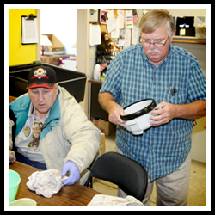

The Division of Rehabilitation Services is here to help people who have limitations to work, find and keep a job. We are the lead agency in the State of Illinois dedicated to helping people with disabilities find employment.

Slide 4



?
Name
Address
Phone Number
Social Security Number
What limitations do you have?
How do we start? We need to know who you are. We will ask some questions to make a referral for services. We have 45 offices around the state.
You can make a referral at any office, over the phone or online. We just need to know your name, address, phone number, Social Security number and what keeps you from finding a job.

Slide 5


We have professional rehabilitation counselors who will contact you for an appointment to discuss getting started. When you attend your appointment, you will be able to talk to the counselor about what you need to get work. If you have any paperwork about your limitations, bring it with you. But, no problem if you don’t. Our counselors will be happy to discover what keeps you from working and how we can develop a plan to find a job.

Slide 6

Do you have income from SSI or SSDI? If you do, you will already be eligible for our services.
If you don’t, we can evaluate medical reports, school records or get new assessments to determine eligibility.

Slide 7


When you become our customer, you can work with the counselor to make your own plan for finding work. What that is, is different for everyone. That’s why we call it, “Individualized.” Some people get training or go to school, some people work with agencies to find work and some just work with the counselor.

Slide 8
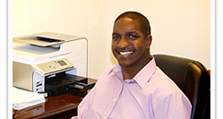

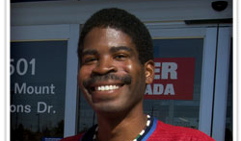

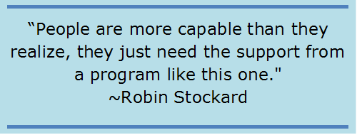
The important thing is that we are here for you. We know you want to earn money to provide for your family, to save for things you need and to be independent.
We are here to help. We understand your benefits and can help you understand how working will add to your income. Although you may have new or old challenges, there are opportunities out there!

Slide 9


www.dhs.state.il.us
Or call the DHS Help Line to find a location near you
1-800-843-6154
1-866-324-5553 TTY
We want to help you get and keep a job. Make a referral today! You can go online to www.dhs.state.il.us and click “Apply Online” or call 1-800-843-6154 to find a location near you.

